Slide 1

MAPPING LAND COVER AND LAND USE CHANGE IN LAIKIPIA County
PROJECT BY; MICHAEL SIRYA MWARUAH
REG NO: F19/1929/2014
SUPERVISOR : MR. JASPER MWENDA

Slide 2
CONTENTS
Problem Statement
Objectives
Methodology
Results
Conclusions
Recommendations

Slide 3
Problem Statement
Land Use/Cover change could be beneficial or detrimental.
Detrimental impacts are the chief cause of concern as they infringe on human wellbeing.
Laikipia County has been on the spotlight recently for conflict that may be the result of these changes.

Slide 4
Main Objective
To map land cover and land use changes in Laikipia County.

Slide 5
Specific objectives
Determine trend, nature, location and magnitude of land use and land cover change in Laikipia County.
Explain the land use and land cover changes in Laikipia County.
Review the possible causes of land use land cover changes in Laikipia County.

Slide 6
Summary of Methodology
Data Acquisition
Image pre-processing and Classification
GIS Overlay
Accuracy Assessment
Analysis
Results and Discussions

Slide 7
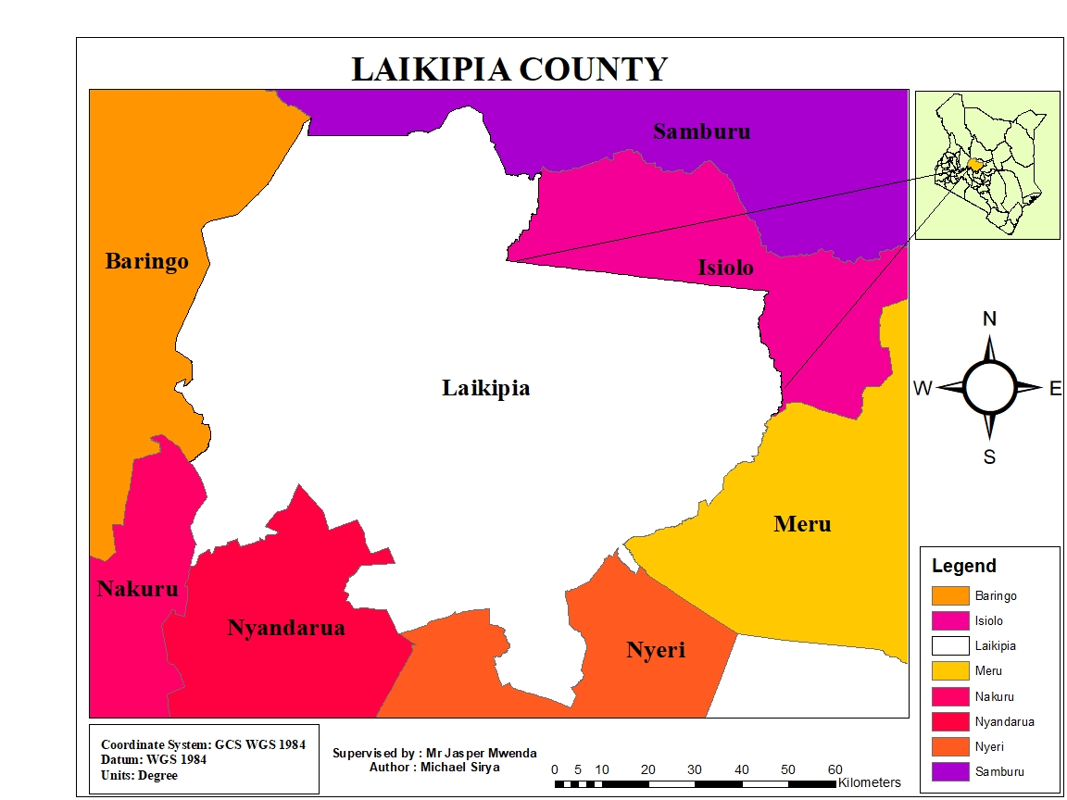
Study Area

Slide 8
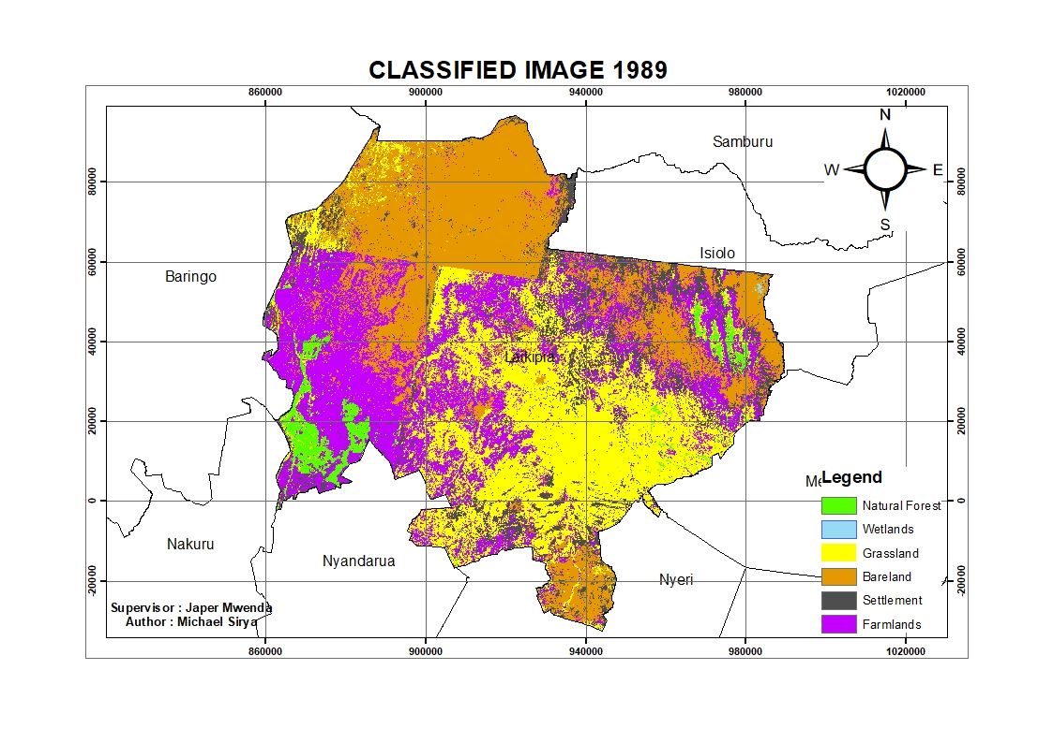

Slide 9
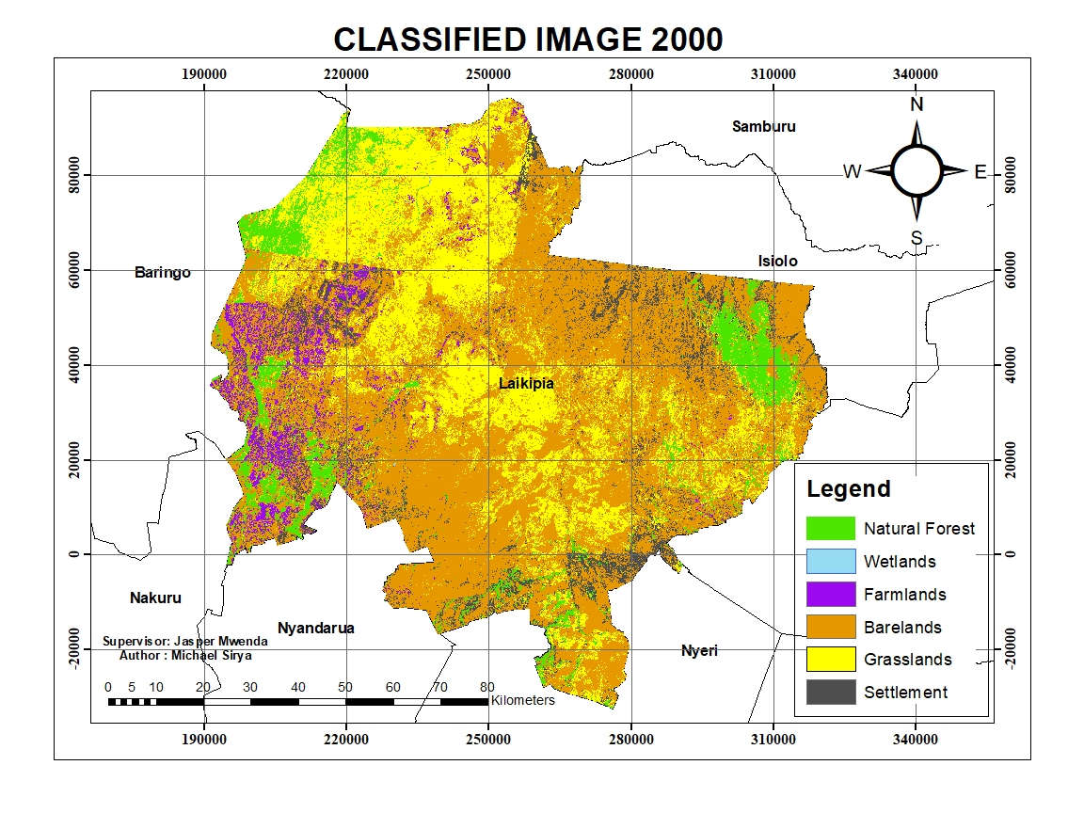

Slide 10
Results
 | 1989 |  | 2000 |  | 2009 |  | 2018
 | Area (Ha) | Area% | Area (Ha) | Area% | Area (Ha) | Area% | Area (Ha) | Area%
Natural Forest | 41667 | 4.4 | 70828 | 7.4 | 12855 | 1.4 | 21152 | 2.2
Wetlands | 1201 | 0.1 | 538 | 0.06 | 236 | 0.02 | 370 | 0.04
Settlements | 63825 | 6.7 | 63139 | 6.6 | 112413 | 11.8 | 215143 | 22.5
Farms | 179864 | 18.8 | 34231 | 3.6 | 88580 | 9.3 | 130833 | 13.7
Bare land | 359884 | 37.6 | 540407 | 56.6 | 310227 | 32.5 | 371363 | 38.9
Grasslands | 310615 | 32.5 | 245216 | 25.7 | 361521 | 37.9 | 165621 | 17.4
Cloud/No data | 0 | 0 | 0 | 0 | 68531 | 7.2 | 49880 | 5.2
Total | 957056 | 100 | 954358 | 100 | 954364 | 100 | 954361 | 100

Slide 11
Accuracy Assessment
 | 1989 | 2000 | 2009 | 2018
Overall Accuracy | 88% | 86.17% | 91.76% | 86.59%
Kappa Coefficient | 0.8542 | 0.8307 | 0.9 | 0.8424

Slide 12
Graphical presentation of land use/cover change from the 1989 to 2018

Slide 13
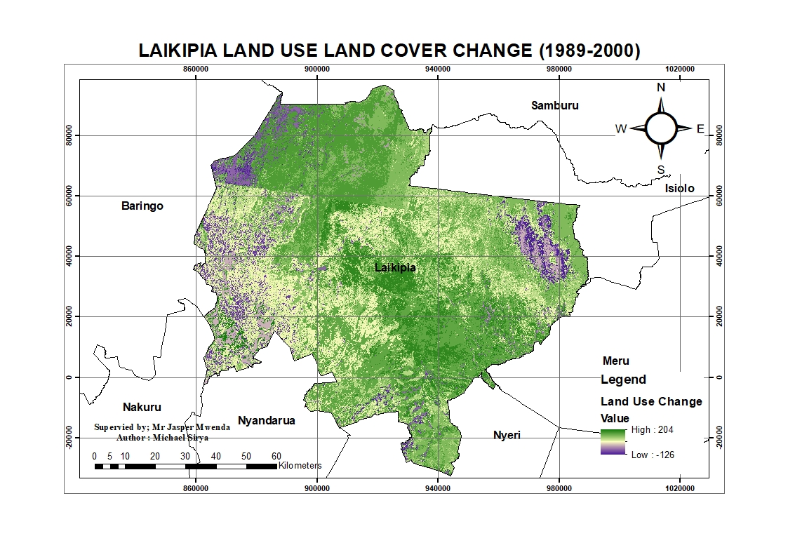

Slide 14
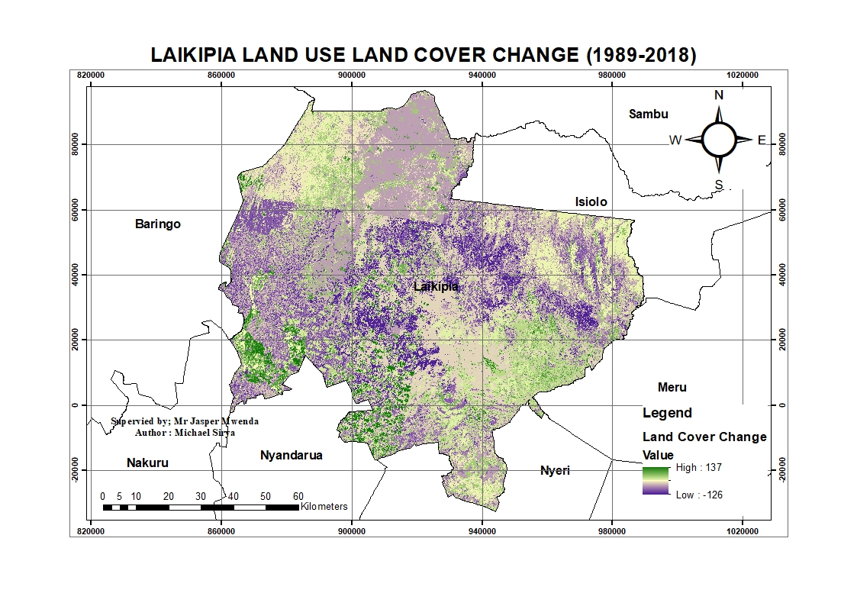

Slide 15
Trends in Land Use/Cover changes

Slide 16
Trends in Land Use/Cover changes

Slide 17
Conclusions
The mapping of land cover/land use change was successful .
The trends, nature, location and magnitude of the Land cover/Use changes in this project were successfully determined.

Slide 18
Recommendations
The same study should be done in various counties to inform land use planning
Continued land cover/land use change mapping should be done to enable resource management for sustainable development.
Conservation measures should be increased to deal with the declining forest cover

Slide 19
THANK YOU!

